Slide 1
Name of Your Project (Add a background. Either a pattern or a picture)

Slide 2
Team Members
Add the names of your Team, what grade you are in, & what specifically interests you about Architecture, Engineering and/or Construction.
Susie Everyone – 10th Grade. I like how a building protects people.
John Doe – 9th Grade. I love to build things and see them become real.
Usef Latif – 11th Grade. To me a building is artistic and represents the designer’s view of the world.

Slide 3
Project Purpose
What goals are you trying to achieve?
What is your building being used for?
How will it benefit to Annapolis?
Etc.

Slide 4
Site Plan
Add a Google Maps screen shot or draw the existing site with your building footprint drawn on it.
Label the features (For example: Parking, Outdoor Dining, Surrounding businesses & restaurants, etc.
Describe the site features
Examples: In downtown Annapolis
A public space
Subject to flooding
Existing road, water, electrical infrastructure
Etcetera
Existing Site Plan

Slide 5
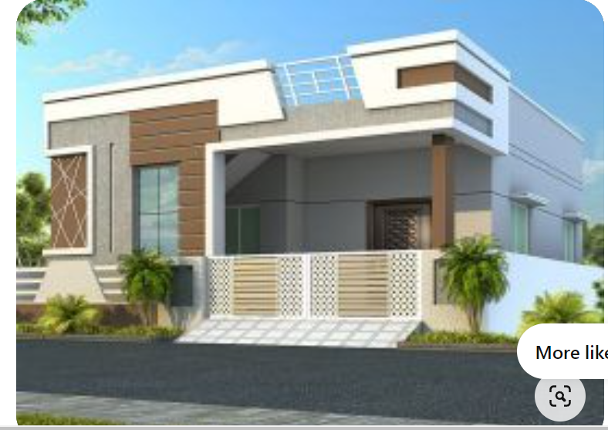
Building Rendering
Show your Building rendering here.

Slide 6
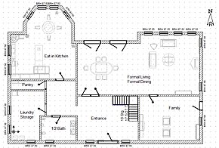
Building Plan
Show your Building Plan here.

Slide 7
Design Influences
Add images of what design ideas you want to use.
You can have more than this one slide. You can add slides.
You can find images for all of your presentation slides by Googling “ Name Images ”… For Example: “Green Wall Images”, “Brick Images”, “Window Images”, “Light Fixture Images”, etc.
You can use any of the photographs of “The Existing Market Place Photos” that are in the Goggle Docs folder.
You can take photographs of anything you see IRL and include them here.

Slide 8
Green Strategies
What Green strategies are you including in your project?

Slide 9
Structural Design
Add images of what you want to use for the structure of your building.
You can also add bullet points…For example:
”We will use the existing steel structure to save money”
“Our new building will be made of wood in order to be more sustainable”
“We will use concrete so that it looks more modern.”
Etc.

Slide 10
Mechanical
Add images of your proposed mechanical system (s)
(Heat, Ventilation, Air Conditioning)
You can also add bullet points to any of the slildes in your presentation.

Slide 11
Electrical
Add images of your solar panels, lights, and any other electrical items or systems.

Slide 12
Plumbing
Add images of your proposed plumbing fixtures or plumbing systems.
Sinks, toilets, water fountains, dish washer, etc.

Slide 13
Construction
Construction Cost: $$$ (per sq.ft cost)
Permits required: Maryland Department of the Environment, City of Annapolis, etc.
Project Duration: from start to substantial completion timeline including permit submission.

Slide 14
Dgsdkfgkqerhferfure
Closing slide

